Slide 1

Cyber Attack Countermeasures
Understanding cryptography and secure communication
Presentation number 2
Intern: Assil Bzal

Slide 2
Outline
From Secrets to Security: The Evolution of Cryptography
Conventional Cryptography and Its Challenges
Public Key Cryptography: Basics, Secrecy, and Digital Signatures
Cryptographic Message Exchange and Key Management
Secure Communication Protocols: SSL

Slide 3
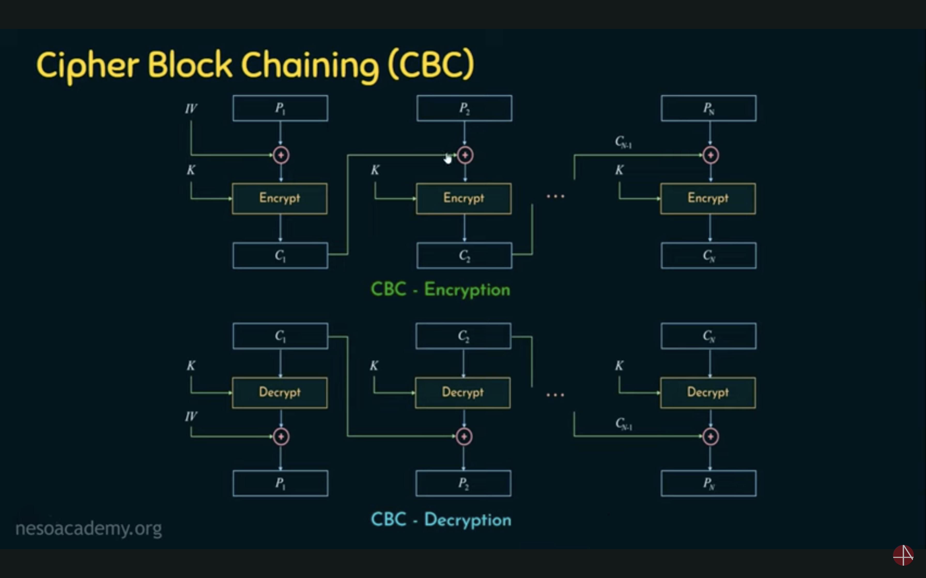
CBC mode block cryptography
CBC = Cipher Block Chaining
Encrypts data in blocks
Each block depends on the previous block
Prevents repeating patterns

Slide 4
Conventional cryptography scaling issues
Symmetric encryption uses one key for both encryption and decryption.
Each pair of users needs a unique secret key.
As the number of users grows, the number of required keys grows rapidly.
Formula: Number of keys = n(n−1)/2
Key distribution and management becomes a serious challenge.

Slide 5
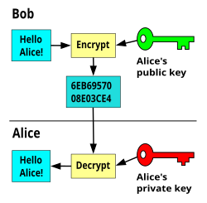
Public key cryptography
Asymmetric system → two keys instead of one
Public key: shared openly, used to encrypt
Private key: kept secret, used to decrypt
Solves the scaling issue of symmetric cryptography
Analogy: Mailbox → anyone can drop letters in, only the owner can open
Secrecy: Protects messages from eavesdroppers, public key encrypts, private key decrypts, solves key distribution problem
Digital signatures: Verifies authenticity of sender, private key signs message, public key verifies signature

Slide 6
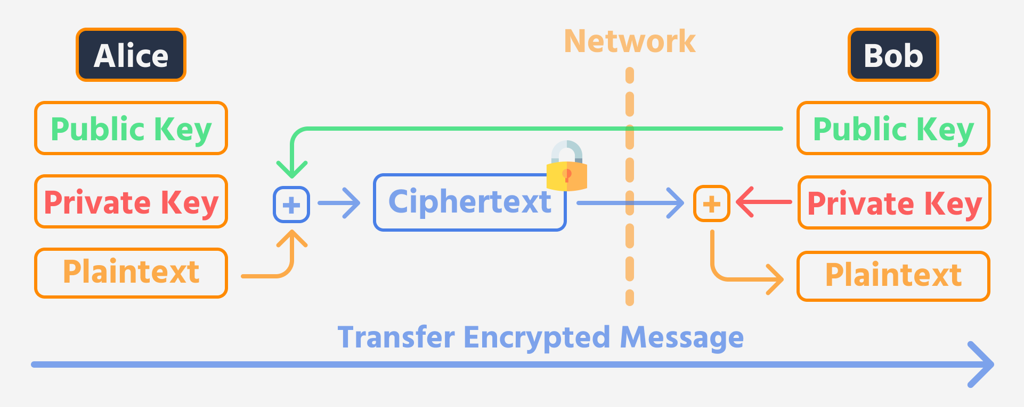
Cryptographic Message Exchange
Combines encryption & signatures
Ensures confidentiality, integrity, authenticity
Enables secure communication between parties

Slide 7
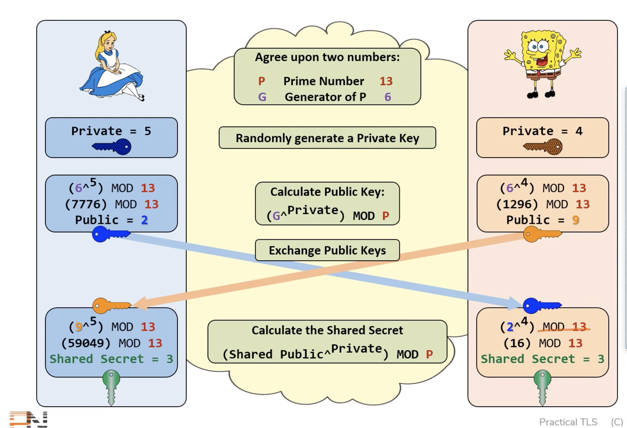
Diffie-Hellman Key Exchange
Allows secure key agreement over insecure channel
Both parties create a shared secret without transmitting it.

Slide 8
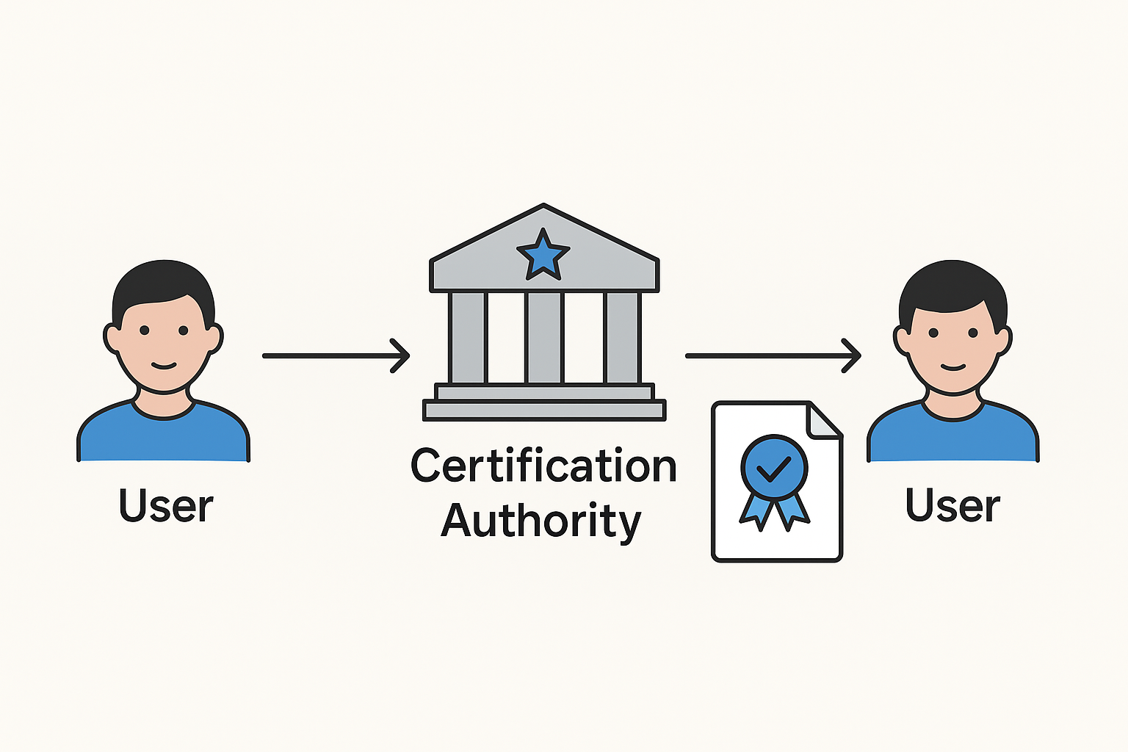
Key Distribution and Certification Authority
Problem: How do you know a public key really belongs to the person who claims it?
Key Distribution: securely sharing public keys with users.
Certification Authority (CA): trusted third party that verifies identities.
CA issues digital certificates linking a person/organization to their public key.
Builds a chain of trust across networks (the “PKI” system).

Slide 9
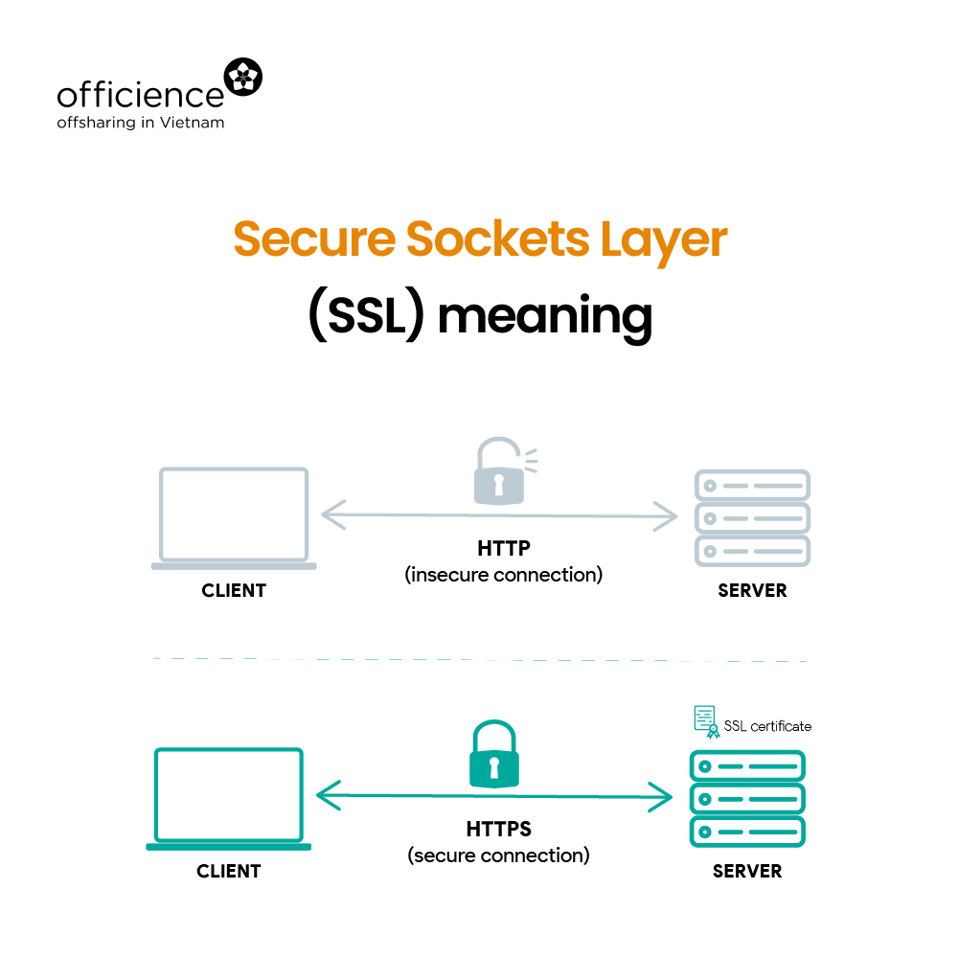
Secure Sockets Layer (SSL)
Protocol for secure communication on the web
Uses encryption, key exchange, and digital certificates
HTTPS = HTTP + SSL

Slide 10
Conclusion / Key Takeaways
Cryptography protects secrecy and authenticity
Public key systems solve scaling challenges
Key exchange & certificates enable trust
SSL shows practical implementation

